Slide 1

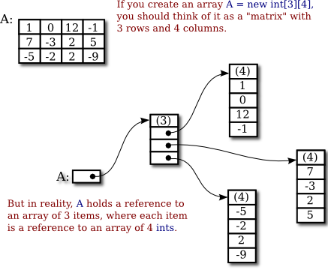
Introduction to Computer Science
Reichman University
Lecture 5-1
Two-Dimensional Arrays
Notes:
‹#›

Slide 2
Lecture 5-1 Topics
This lecture focuses on the following topics:
1. Two-Dimensional Arrays:
• Concept of 2D arrays as arrays of 1D arrays.
• Row and column indexing starting at 0.
• Accessing elements via a[row][col].
• Examples, including summing rows and displaying matrix data.
2. Matrix Operations:
• Addition and multiplication of matrices.
• Conditions for operations (e.g., dimensions compatibility for multiplication).
• Examples of implementing and testing matrix addition and multiplication.
3. Reading and Processing Files:
• Using file readers to process data from text files.
• Example: Counting the frequency of integers from a file.
4. PageRank Algorithm:
• Introduction to Google’s PageRank for ranking web pages based on importance.
• Modeling web pages as a graph with transition probabilities.
• Steps to compute page ranks using random walks, transition matrices, and cumulative distribution functions (CDF).
• Implementation details and an example to compute PageRanks for a web graph.
This lecture combines programming concepts with practical examples, focusing on implementing algorithms and processing data effectively.

Slide 3
Two dimensional arrays
movie rating: (1 to 5)
sales data (units)
movie id
quarter
 | 0 | 1 | 2 | 3 | 4
0 | 4 | 5 | 4 | 5 | 4
1 | 5 | 3 | 4 | 4 | 4
2 | 3 | 4 | 3 | 5 | 3
 | 1 | 2 | 3 | 4
1 | 10 | 12 | 20 | 12
2 | 12 | 14 | 25 | 18
3 | 14 | 16 | 22 | 17
4 | 9 | 12 | 35 | 20
5 | 11 | 15 | 30 | 22
reviewer id
model
image (black / white pixels)
image (greyscale pixels)
column
column
 | 0 | 1 | 2 | 3 | 4 | 5 | 6 | 7
0 | 0 | 0 | 0 | 0 | 0 | 0 | 0 | 0 | 0
1 | 0 | 0 | 1 | 1 | 1 | 1 | 0 | 0 | 0
2 | 0 | 0 | 0 | 1 | 1 | 1 | 1 | 0 | 0
3 | 0 | 0 | 0 | 0 | 1 | 1 | 1 | 1 | 0
4 | 0 | 0 | 0 | 0 | 0 | 0 | 0 | 0 | 0
 | 0 | 0 | 0 | 0 | 0 | 0 | 0 | 0 | 0
 | 0 | 1 | 2 | 3 | 4 | 5 | 6 | 7
0 | 0 | 0 | 0 | 0 | 0 | 0 | 0 | 0 | 0
1 | 0 | 0 | 0 | 0 | 0 | 0 | 0 | 0 | 0
2 | 0 | 255 | 255 | 255 | 255 | 255 | 0 | 0 | 0
3 | 0 | 112 | 17 | 17 | 83 | 83 | 0 | 0 | 0
4 | 0 | 76 | 76 | 63 | 63 | 63 | 0 | 0 | 0
 | 0 | 0 | 0 | 0 | 0 | 0 | 0 | 0 | 0
...
...
row
row
...
...

Slide 4
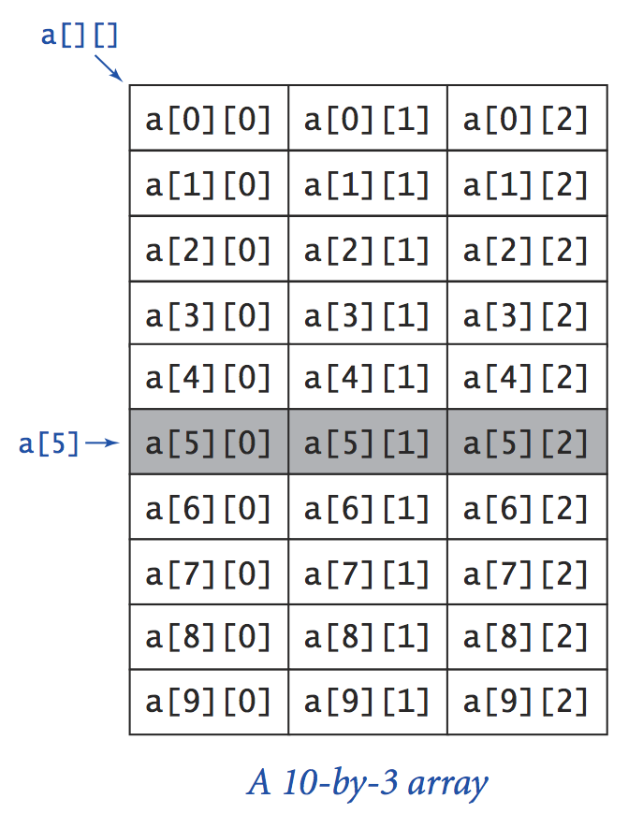
Two dimensional arrays
Technically speaking
A 2D array is an array of 1D arrays
“Row” a[i] is a 1D array whose elements are:
a[i][0], a[i][1], a[i][2]
Conventions
Row and column indexes start at 0
The (row,col) element is accessed by a[row][col]
Number of rows: a.length
Number of elements in row i: a[i].length

Slide 5
Example
// Computes the sums of the rows in a table.
// Stores the sums in the rightmost column.
public class SumOfRow {
public static void main(String[] args) {
// Defines a 5 by 4 2D array, and puts random values in the
// range 0...19 in the leftmost 3 columns, for testing
int[][] arr = new int[5][4];
for (int i = 0; i < 5; i++) {
for (int j = 0; j < 3; j++) {
arr[i][j] = (int) (20 * Math.random());
}
}
// Stores the sum of each row at the rightmost column
for (int i = 0; i < 5; i++) {
int sum = 0;
for (int j = 0; j < 3; j++) {
sum = sum + arr[i][j];
}
arr[i][3] = sum;
}
// Prints the array
for (int i = 0; i < 5; i++) {
for (int j = 0; j < 4; j++) {
System.out.printf("%4s", arr[i][j]);
}
System.out.println();
}
}
}
% java SumOfRow
6 10 6 22
7 11 17 35
3 15 1 19
14 6 13 33
13 6 0 19
sum of each row
Prints the value using 4 positions, right justified.

Slide 6
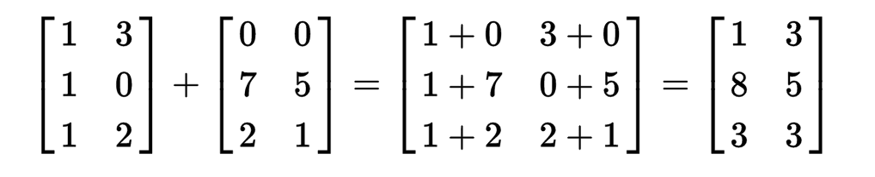
Matrix operations
Addition
Precondition: The two matrices must have the same dimensions.
// Computes the matrix addition sum = m1 + m2
// Assumes that m1, m2 have the same dimensions
int N = m1.length; // number of rows
int M = m1[0].length; // number of columns
int[][] sum = new int[N][M];
for (int i = 0; i < N; i++) {
for (int j = 0; j < M; j++) {
sum[i][j] = m1[i][j] + m2[i][j];
}
}

Slide 7
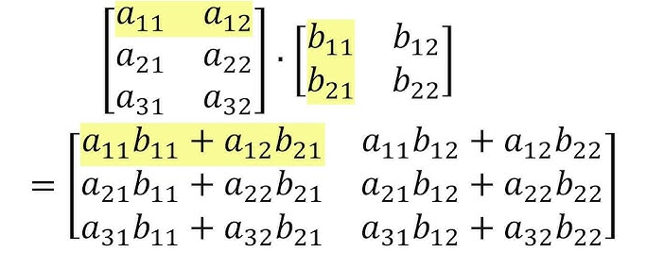
Matrix operations
Multiplication
Precondition: The two matrixes must have compatible dimensions: the number of columns in the left matrix must equal the number of rows in the right matrix.

Slide 8
Matrix operations
/** Features matrix operations */
public class MatrixOps {
/** Returns the matrix addition m1 + m2. Assumes that they have the same dimensions. */
public static int[][] add(int[][] m1, int[][] m2)
/** Returns the matrix multiplication m1 * m2. Assumes that they have compatible dimensions. */
public static int[][] mult(int[][] m1, int[][] m2)
/** Prints the given matrix. */
public static void println(int[][] m)
}
/** Features matrix operations. */
public class MatrixOps {
// Illustrates using the class functions
public static void main(String args[]) {
int[][] a = { { 7, 2, 1 },
{ 3, 6, 1 },
{ 5, 1, 4 } };
int[][] b = { { 8, 3, 5 },
{ 1, 4, 1 },
{ 1, 3, 4 } };
println(a);
println(b);
println(add(a, b));
println(mult(a, b));
...
// Creates and computes c = a ⨉ (a + b)
int[][] c = mult(a, add(a, b));
// Computes c = (a + c) ⨉ b + c
c = add((mult(add(a, c), b), c);
...
}
/** Returns the addition of the two given matrices */
public static int[][] add(...) {...}
/** Returns the product of the two given matrices */
public static int[][] mult(...) {...}
/** Prints the given matrix. */
private static void println(int[][] m) {...}
}
MatrixOps API
% java MatrixOps
7 2 1
3 6 1
5 1 4
8 3 5
1 4 1
1 3 4
15 5 6
4 10 2
6 4 8
59 32 41
31 36 25
45 31 42
a
b
a + b
a ⨉ b

Slide 9
Matrix operations
/** Features matrix operations */
public class MatrixOps {
/** Returns the matrix addition m1 + m2. Assumes that they have the same dimensions. */
public static int[][] add(int[][] m1, int[][] m2)
/** Returns the matrix multiplication m1 * m2. Assumes that they have compatible dimensions. */
public static int[][] mult(int[][] m1, int[][] m2)
/** Prints the given matrix. */
public static void println(int[][] m)
}
/** Features matrix operations. */
public class MatrixOps {
// Illustrates using the class functions
public static void main(String args[]) {
int[][] a = { { 7, 2, 1 },
{ 3, 6, 1 },
{ 5, 1, 4 } };
int[][] b = { { 8, 3, 5 },
{ 1, 4, 1 },
{ 1, 3, 4 } };
println(a);
println(b);
println(add(a, b));
println(mult(a, b));
...
// Creates and computes c = a ⨉ (a + b)
int[][] c = mult(a, add(a, b));
// Computes c = (a + c) ⨉ b + c
c = add((mult(add(a, c), b), c);
...
}
/** Returns the addition of the two given matrices */
public static int[][] add(...) {...}
/** Returns the product of the two given matrices */
public static int[][] mult(...) {...}
/** Prints the given matrix. */
private static void println(int[][] m) {...}
}
MatrixOps API
% java MatrixOps
7 2 1
3 6 1
5 1 4
8 3 5
1 4 1
1 3 4
15 5 6
4 10 2
6 4 8
59 32 41
31 36 25
45 31 42
Notice how add, mult, println are used as black box abstractions;
We will now open up the black boxes.
a
b
a + b
a ⨉ b

Slide 10
Matrix operations
Implementation
/** Features matrix operations. */
public class MatrixOps {
public static void main(String args[]) {
// Performs various tests (see previous slides)
}
/** Returns a matrix which is the addition of the two given matrices. Assumes they have the same dimensions. */
public static int[][] add(int[][] m1, int[][] m2) {
int N = m1.length; // number of rows
int M = m1[0].length; // number of columns
int[][] sum = new int[N][M];
for (int i = 0; i < N; i++) {
for (int j = 0; j < M; j++) {
sum[i][j] = m1[i][j] + m2[i][j];
}
}
return sum;
}
/** Returns a matrix which is the product of the two given matrices. Assumes that they have compatible dimensions. */
public static int[][] mult(int[][] m1, int[][] m2) {
//// Replace the following statement with your code
retrun null;
}
/** Prints the given matrix, and moves the cursor to the next line. */
public static void println(int[][] m) {
//// Similar to the sumOfRow example
}
}

Slide 11
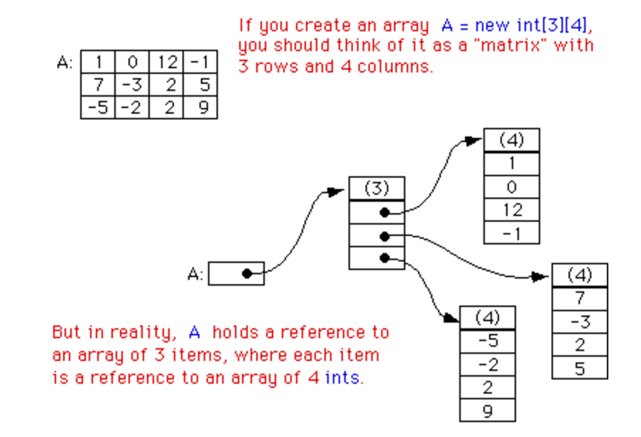
2D arrays: Abstraction and implementation
...
int[][] arr = { { 1, 0, 12, -1 },
{ 7, -3, 2, 5 },
{-5, -2, 2, 9 }, };
...
Abstract view
Physical view
arr:
arr:
A 2D array is implemented as a 1D array of references, each pointing to a 1D array.

Slide 12
Reading / processing a file
Example: Counts how many times integer values appear in a file.
OS function: displays the file
% more demo.dat
4
1 1 2
0 1 3 0 3
0 1
% java ReadFileDemo
0: 3
1: 4
2: 1
3: 2
/** Represents a standard input stream. Provides methods for controlling and reading values from this input */
public class In {
/** Initializes a new input stream from the given file. */
In(String fileName)
/** Reads the next token from the input,
* parses it as an integer, and returns the integer. */
public int readInt()
/** Returns true if the input is empty. */
public boolean isEmpty()
// More In functions follow.
}
In class API

Slide 13
Reading / processing a file
Example: Counts how many times integer values appear in a file.
OS function: displays the file
% more demo.dat
4
1 1 2
0 1 3 0 3
0 1
% java ReadFileDemo
0: 3
1: 4
2: 1
3: 2
/** Reads all the values in a file, skipping white space, and prints their * frequency. Precondition: The first value in the file, say N, indicates * that each value in the file is a non-negative int < N. */
public class ReadFileDemo {
public static void main(String[] args) {
// Creates a new input stream and sets in to refer to it
In in = new In("demo.dat");
// Reads the upper-limit of the values
int N = in.readInt();
// Creates a frequency array
int[] count = new int[N];
// Reads and counts the values
while (!in.isEmpty()); {
int x = in.readInt();
count[x]++;
}
// Prints the frequency array
for (int i = 0; i < N; i++)
System.out.println(i + ": " + count[i]);
}
}
Example of object-based programming: in is an object of type In. It has data and methods
/** Represents a standard input stream. Provides methods for controlling and reading values from this input */
public class In {
/** Initializes a new input stream from the given file. */
In(String fileName)
/** Reads the next token from the input,
* parses it as an integer, and returns the integer. */
public int readInt()
/** Returns true if the input is empty. */
public boolean isEmpty()
// More In functions follow.
}
Main point of this exercise: Illustrates reading a text files using an object-based file reader (In object)
In class API

Slide 14

PageRank
PageRank Algorithm
How to Rank Web Pages According to their “Importance”

Slide 15
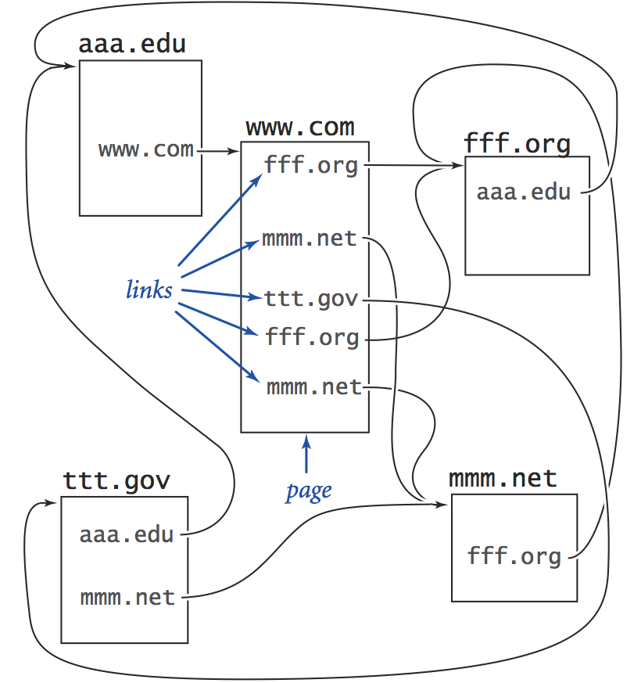
PageRank
Model of the web (consisting of 5 pages with hyperlinks):
abs
abs
The challenge: Rank web pages according to their importance
Importance: (i) the more visits a page gets, the more important it becomes
(ii) pages that get visits from important pages become more important
PageRank: The algorithm that Google uses to measure importance.

Slide 16
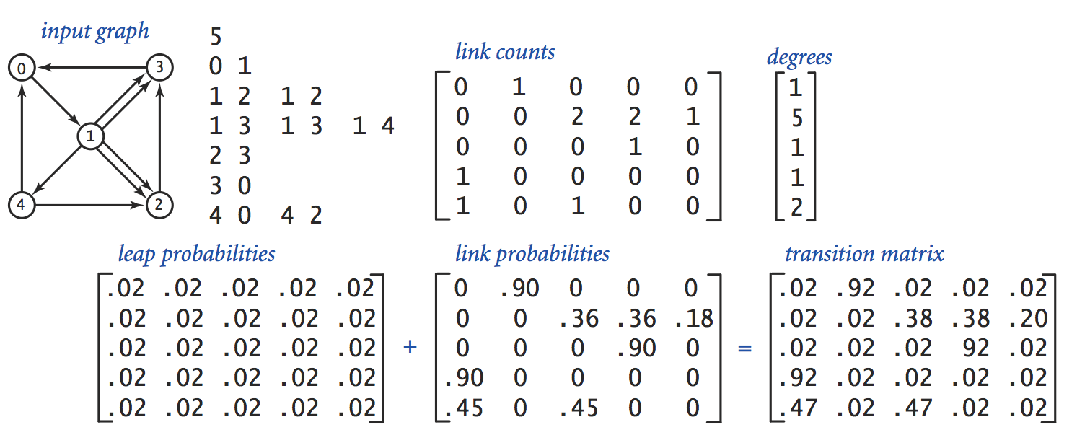
Model
Model of the web (consisting of 5 pages with hyperlinks):
graph model
data file
0
number of pages (N)
3
links
1
2
4
The challenge: Rank web pages according to their importance
Importance: (i) the more visits a page gets, the more important it becomes
(ii) pages that get visits from important pages become more important
PageRank: The algorithm that Google uses to measure importance.

Slide 17
Data structures
data file
nLink
nLinks
public class PageRank {
public static void main(String[] args) {
// Creates an In object for representing the input (file)
In in = new In("web.dat");
int N = in.readInt(); // number of pages
int[][] nLink = new int[N][N]; // nLink[i][j]: number of links from page i to page j
int[] nLinks = new int[N]; // nLinks[i]: total number of outgoing links from page i
// Reads the links data and computes the link counts
while (!in.isEmpty()) {
int row = in.readInt();
int col = in.readInt();
nLink[row][col]++;
nLinks[row]++;
}
...
/** Represents a standard input stream. Provides methods for controlling and reading values from this input */
public class In {
/** Initializes a new input stream from the given file. */
In(String fileName)
/** Reads the next token from the input,
* parses it as an integer, and returns the integer. */
public int readInt()
/** Returns true if the input is empty. */
public boolean isEmpty()
// More In functions follow.
}

Slide 18
Data structures
data file
nLink
nLinks
+
=
p1[i][j] = probability of “leaping” from page i to page j
p2[i][j] = probability of going from page i to page j by clicking a link
p[i][j] = probability of going from page i to page j
Web surfing behavior (working assumption of PageRank):
When a user visits a page:
10% of the time the user “leaps” to some random page with equal probability
90% of the time the user clicks a random hyperlink within the current page

Slide 19
Data structures
data file
nLink
nLinks
+
=
. . .
// Reads the data file and constructs the nLinks and nLink matrices (previous slide)
. . .
// Constructs the transition matrix
double[][] transition = new double[N][N];
for (int i = 0; i < N; i++) {
for (int j = 0; j < N; j++) {
transition[i][j] = .10 / N +
.90 * ((double) nLink[i][j] / nLinks[i]);
}
}

Slide 20
Algorithm
transition matrix
.02 .92 .02 .02 .02
.02 .02 .38 .38 .20
.02 .02 .02 .92 .02
.92 .02 .02 .02 .02
.47 .02 .47 .02 .02
p[i][j] = probability that a random user goes from page i to page j
PageRank Algorithm
// Simulates a random user that makes T moves from one page to another.
// Counts how many times each of the N pages will be visited.
int[] count = int [N] // stores how many times each page was visited so far
page = 0 // starts the random walk at page 0
repeat T times:
// Selects the next page, using the row probabilities (Monte Carlo)
page = select a random integer from 0, ... , N – 1 with probability p[page , 0], ..., p[page , N – 1]
count [page]++
// Normalizes the page counts
for i = 0, ..., N – 1:
pageRank[i] = count [i] / T
In order to perform this simulation, we first have to compute the Cumulative Distribution Functions

Slide 21
Algorithm
transition matrix (PDFs)
CDFs matrix
.02 .92 .02 .02 .02
.02 .02 .38 .38 .20
.02 .02 .02 .92 .02
.92 .02 .02 .02 .02
.47 .02 .47 .02 .02
page 0:
page 1:
page 2:
page 3:
page 4:
.02 .94 .96 .98 1.00
.02 .04 .42 .80 1.00
.02 .04 .06 .98 1.00
.92 .94 .96 .98 1.00
.47 .49 .96 .98 1.00
PageRank Algorithm
// Simulates a random user that makes T moves from one page to another.
// Counts how many times each of the N pages will be visited.
int[] count = int [N] // stores how many times each page was visited so far
page = 0 // starts the random walk at page 0
repeat T times:
// Selects the next page, using the row probabilities (Monte Carlo)
page = select a random integer from 0, ... , N – 1 with probability p[page , 0], ..., p[page , N – 1]
count [page]++
// Normalizes the page counts
for i = 0, ..., N – 1:
pageRank[i] = count [i] / T
In order to perform this simulation, we first have to compute the Cumulative Distribution Functions

Slide 22
Algorithm
transition matrix (PDFs)
CDFs matrix
.02 .92 .02 .02 .02
.02 .02 .38 .38 .20
.02 .02 .02 .92 .02
.92 .02 .02 .02 .02
.47 .02 .47 .02 .02
page 0:
page 1:
page 2:
page 3:
page 4:
.02 .94 .96 .98 1.00
.02 .04 .42 .80 1.00
.02 .04 .06 .98 1.00
.92 .94 .96 .98 1.00
.47 .49 .96 .98 1.00
. . .
// Computes the CDF's of the PDF's represented by the transition matrix
double[][] CDF = new double[N][N];
for (int i = 0; i < N; i++) {
CDF[i] = MyRandom.CDF(transition[i]);
}
. . .
/** Library of statistical and random functions.*/
public class MyRandom {
/** Creates a CDF from a given PDF. */
public static double[] CDF(double[] p)
/** Generates a random integer from a given CDF. */
public static int rnd(double[] P)
...
}
How to construct a CDF from a PDF, and how to generate random events using a CDF, was described in lecture 4-1.
MyRandom API

Slide 23
Implementation
CDFs matrix
page 0:
page 1:
page 2:
page 3:
page 4:
.02 .94 .96 .98 1.00
.02 .04 .42 .80 1.00
.02 .04 .06 .98 1.00
.92 .94 .96 .98 1.00
.47 .49 .96 .98 1.00
...
// Reads the data file and constructs the transition and CDF matrices (previous slides)
...
// Simulates the behavior of a user who makes T random moves (command-line argument).
// In each move, a random page is selected using the transition probability from the current page.
int[] count = new int[N]; // how many times each page was visited
int T = Integer.parseInt(args[0]); // number of simulated moves from one page to another
int page = 0; // Starts at page 0
// Makes T moves
for (int t = 0; t < T; t++) {
// Selects randomly which page to go to
page = MyRandom.rnd(CDF[page]);
count[page]++;
}
// End of simulation: Prints the pageranks the pages
for (int i = 0; i < N; i++)
System.out.print((double) count[i] / T);
/** Library of statistical and random functions.*/
public class MyRandom {
/** Creates a CDF from a given PDF. */
public static double[] CDF(double[] p)
/** Generates a random integer from a given CDF. */
public static int rnd(double[] P)
...
}
MyRandom API

Slide 24
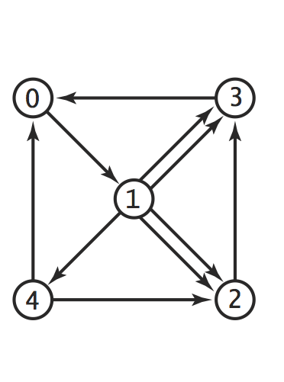
Results
0.27
0.24
% more web.dat
5
0 1
1 2 1 2
1 3 1 3 1 4
2 3
3 0
4 0 4 2
% java PageRank 10000000
Page ranks:
0.273 0.266 0.146 0.247 0.068
0.26
0.06
0.14

Slide 25
PageRank class (all the pieces together, nothing new in this slide)
public class PageRank {
public static void main(String[] args) {
// Creates an In object for representing the input (file)
In in = new In("web.dat");
int N = in.readInt(); // number of pages
int[][] nLink = new int[N][N]; // nLink[i][j]: number of links from page i to page j
int[] nLinks = new int[N]; // nLinks[i]: total number of outgoing links from page i
// Reads the links data and computes the link counts
while (!in.isEmpty()) {
int row = in.readInt();
int col = in.readInt();
nLink[row][col]++;
nLinks[row]++; }
// Constructs the transition matrix
double[][] transition = new double[N][N];
for (int i = 0; i < N; i++)
for (int j = 0; j < N; j++)
transition[i][j] = .10 / N + .90 * ((double) nLink[i][j] / nLinks[i]);
// Computes the CDF's of the PDF's represented by the transition matrix
double[][] CDF = new double[N][N];
for (int i = 0; i < N; i++)
CDF[i] = MyRandom.CDF(transition[i]);
// Simulates the behavior of a user who makes T random moves.
// In each move, a random page is selected from the current page.
// The random selection is made using the CDF of the current page.
int[] count = new int[N]; // how many times each page was visited
int T = Integer.parseInt(args[0]); // number of simulated moves from one page to another
int page = 0; // Starts at page 0
// Makes T moves
for (int t = 0; t < T; t++) {
// Selects randomly which page to go to
page = MyRandom.rnd(CDF[page]);
count[page]++;
}
System.out.println("Page ranks:");
for (int i = 0; i < N; i++) { System.out.printf("%7.3f", (double) count[i] / T); }
}
}
% more web.dat
5
0 1
1 2 1 2
1 3 1 3 1 4
2 3
3 0
4 0 4 2
% java PageRank 10000000
Page ranks:
0.273 0.266 0.146 0.247 0.068

